Slide 1


SAVEETHA SCHOOL OF ENGINEERING SAVEETHA INSTITUTE OF MEDICAL AND TECHNICAL SCIENCES
PROJECT TITLE
SPAM CLASSIFICATION
CSA1370 – THEORY OF COMPUTATION FOR QUANTUM COMPUTING
Project By
M . Sai Tejaswini
(192210602)
P . Pavithra
(192210611)
CSE
SSE,SIMATS
GUIDED BY:
Dr . Latha
(course faculty)
SSE ,SIMATS

Slide 2
CONTENTS
Abstract
Introduction
Types of Spam Classification
Pros and Cons spam classification
Architecture
Features of spam classification
Conclusion
Reference

Slide 3
ABSTRACT
Spam classification is a process in natural language processing (NLP) used to automatically identify unsolicited and irrelevant messages, commonly known as spam, from legitimate or "ham" messages. This is crucial in applications such as email filtering, social media moderation, and SMS classification. The primary challenge in spam classification is differentiating between spam and non-spam messages accurately without blocking important legitimate messages. The classifier is then deployed to identify spam in real-time, continuously improving through feedback and retraining with new data. The goal is to minimize false positives (legitimate messages marked as spam) and false negatives (spam messages not detected). Unwanted text messages are called Spam SMSs .

Slide 4
INTRODUCTION
The goal of spam classification is to distinguish between spam and legitimate messages (often called "ham") by analyzing the content, structure, and metadata of the messages. Over the years, various machine learning and deep learning techniques have been developed to automate this process, significantly improving the efficiency and effectiveness of spam filters.
Traditional spam detection methods, such as rule-based systems or keyword matching, have evolved into sophisticated machine learning models. These models can learn patterns from large datasets, enabling them to generalize better and handle complex cases of spam. Classifiers like Naive Bayes, Decision Trees, Support Vector Machines (SVMs), and more recently, deep learning architectures like Recurrent Neural Networks (RNNs) and Transformers, are used to identify spam with high accuracy.
Effective spam classification not only improves the user experience by reducing unwanted messages but also enhances cybersecurity by preventing malicious content from reaching end-users. As spammers continuously evolve their techniques, ongoing research and advancements in spam classification techniques remain essential to stay ahead in the battle against spam.

Slide 5

TYPES OF SPAM CLASSIFICATION
1.Rule-Based Spam Classification
2. Content-Based Spam Classification
3. Blacklisting and Whitelisting

Slide 6
RULE BASED SPAM CLASSIFICATION
Rule-Based Spam Classification: This method relies on manually created rules to filter spam based on specific patterns in messages. Common rules include looking for specific keywords, phrases, or patterns (such as excessive use of symbols or certain suspicious links).
Advantages: Simple to implement, interpretable, and customizable.
Disadvantages: Not adaptive to new spam patterns, can be bypassed by spammers using obfuscation, and may produce many false positives or negatives.

Slide 7
CONTEXT –BASED SPAM CLASSIFICATION
Content-Based Spam Classification: This method focuses on analyzing the content of the message itself, including the subject line, body text, and any attachments. The features may include:
Word frequency (e.g., "free," "click here," "limited offer")
Term frequency-inverse document frequency (TF-IDF)
Content similarity to known spam messages
Advantages: Helps identify suspicious content directly from the message.
Disadvantages: Can be computationally expensive for large volumes of messages, may miss newer or disguised spam messages.

Slide 8
Blacklisting and Whitelisting
Blacklisting and Whitelisting: This technique involves maintaining lists of known spammers (blacklists) and trusted senders (whitelists). Messages from blacklisted sources are automatically marked as spam, while those from whitelisted addresses are allowed.
Advantages: Simple and quick to implement, highly effective against known spam sources.
Disadvantages: Requires constant updating, can be ineffective for new spam sources, and may lead to false negatives if spammers use new or legitimate-looking addresses.

Slide 9
PROS AND CONS
False Positives (Legitimate Messages Classified as Spam):Drawback: One of the biggest challenges is incorrectly classifying legitimate messages as spam. This can result in missed important communications, which can be costly for businesses or individuals.
Requires Regular Updates
Difficulty in Handling Evolving Spam Techniques
False Negatives (Spam Not Detected):Drawback: Some spam messages may bypass the filter, leading to unwanted clutter or exposure to potential threats. Spammers often evolve their tactics to exploit weaknesses in classification systems.
1.Improves User Experience :Benefit: Filters out unwanted or irrelevant messages, ensuring that users’ inboxes contain primarily important, legitimate content. This reduces clutter and improves productivity.
2. Enhances Security
3. Reduces Network Load
4. Automated Message Filtering:

Slide 10
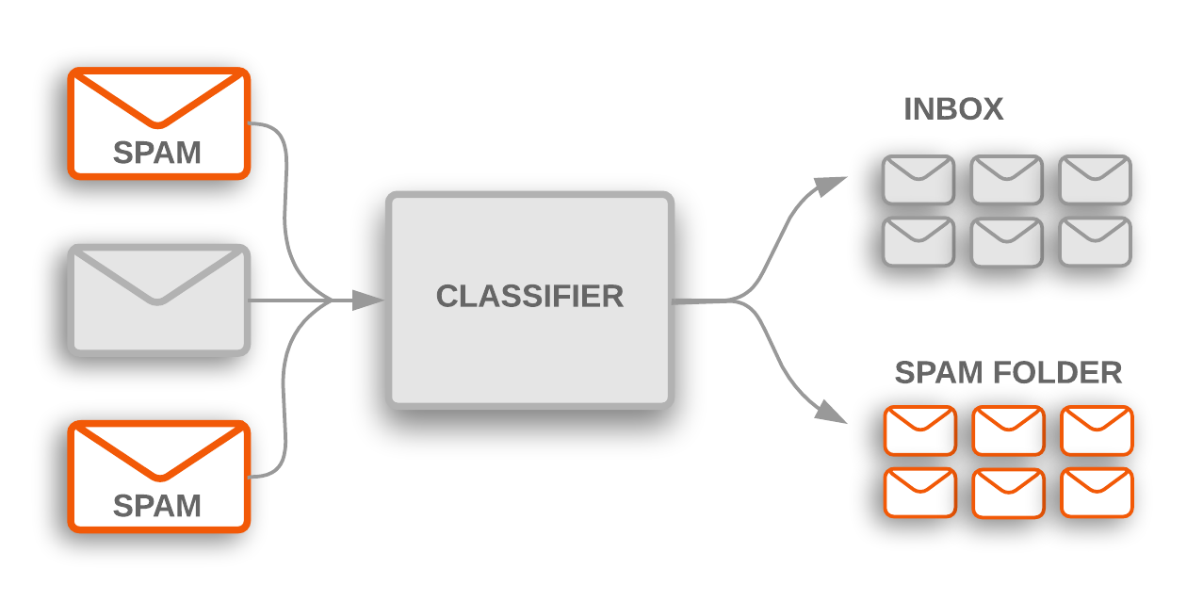
ARCHITECTURE

Slide 11
FEATURES OF SPAM CLASSIFICATION
Content-Based Features:
Word Frequency: The frequency of certain keywords or phrases commonly found in spam emails (e.g., "free", "win", "offer", "money").
N-grams: Sequences of words (bigrams, trigrams) can help identify patterns typical in spam messages.
Email Structure: Features like HTML tags, embedded links, and unusual structures (e.g., too many images or attachments).
Keyword Heuristics: The presence of certain keywords, such as "limited offer" or "urgent", may be indicative of spam.
2. Sender-Based Features:
Sender Reputation: IP address, domain reputation, or email address history can determine whether the sender has previously been associated with spam.
Email Headers: Information in the email header, such as "From", "To", "Subject", and routing information, may indicate spam, especially if spoofing is detected.

Slide 12
CONCLUSION
spam classification is a vital process in maintaining the integrity of communication systems by filtering out unsolicited and potentially harmful messages. It relies on a combination of content-based analysis, sender behavior, link examination, formatting patterns, and advanced machine learning techniques. By leveraging various features such as word frequency, sender reputation, user feedback, and sophisticated algorithms like Naive Bayes and neural networks, spam classification systems are able to effectively distinguish between legitimate and spam messages. Continuous improvements in these models ensure that the filtering process becomes more accurate and adaptive, protecting users from phishing attempts, malware, and other threats.

Slide 13
REFERENCES
A. Helmy, Y. M. Omar, and R. Hodhod. “An innovative word encoding method for text classification using convolutional neural network”. In: 2018 14th international computer engineering conference (ICENCO). IEEE. 2018, 42–47. DOI: 10.1109/ICENCO.2018.8636143.
T. Almeida and J. Hidalgo. SMS Spam Collection v.1. http://www.dt.fee.unicamp.br/~tiago/smsspamcollection/.
P. Sethi, V. Bhandari, and B. Kohli. “SMS spam detection and comparison of various machine learning algorithms”. In: 2017 international conference on computing and communication technologies for smart nation (IC3TSN). IEEE. 2017, 28–31. DOI: 10.1109/IC3TSN.2017.8284445.
P. Navaney, G. Dubey, and A. Rana. “SMS spam filtering using supervised machine learning algorithms”. In: 2018 8th International Conference on Cloud Computing, Data Science & Engineering (Confluence). IEEE. 2018, 43–48. DOI: 10 . 1109 /CONFLUENCE. 2018.8442564.
R. Taheri and R. Javidan. “Spam filtering in SMS using recurrent neural networks”. In: 2017 Artificial Intelligence and Signal Processing Conference (AISP). IEEE.2017, 331–336. DOI: 10.1109/AISP.2017.8515158.
G. Jain, M. Sharma, and B. Agarwal, (2019) “Optimizing semantic LSTM for spam detection" International Journal of Information Technology 11(2): 239–250. DOI: 10.1007/s41870-018-0157-5.

Slide 14


